Slide 1
JPM Quant Challenge 2018

Slide 2
Instructions for use
EDIT IN GOOGLE SLIDES
Click on the button under the presentation preview that says "Use as Google Slides Theme".
You will get a copy of this document on your Google Drive and will be able to edit, add or delete slides.
You have to be signed in to your Google account.
EDIT IN POWERPOINT®
Click on the button under the presentation preview that says "Download as PowerPoint template". You will get a .pptx file that you can edit in PowerPoint.
Remember to download and install the fonts used in this presentation (you’ll find the links to the font files needed in the Presentation design slide)
More info on how to use this template at www.slidescarnival.com/help-use-presentation-template
This template is free to use under Creative Commons Attribution license. You can keep the Credits slide or mention SlidesCarnival and other resources used in a slide footer.

Slide 3
Hello!
I am Jayden Smith
I am here because I love to give presentations.
You can find me at @username

Slide 4
Problem 1: Dynamic Pricing Model

Slide 5
Problem 2: Stock Price Simulation

Slide 6


Problem Statement
Governing equation:$dX_{t}=a\left(θ−X_{t}\right)dt+σ\sqrt{X_{t}}dW_{t}$
Random variable :$dW_{t}=N\left(0,1\right)\sqrt{dt}$
Process similar to GBM
Tendency of $X_{t}$ to reach $θ$
Simulation from t=0 to T=2
Function inputs are $a,θ,X_{0},σ$

Slide 7

Solution Approach
Sub-problem 1 : $E[X_{T=2}]$
Divide time into 100 intervals of resolution $dt=0.02$
Sample $dW_{t}$ in each of these intervals
Propagate $X_{t}$ with time using the governing eq.
Total simulation runs = 10000

Slide 8
Variance Reduction
Output from each run is not same
Final solution is a mean of all the outputs
The lesser the variance in the output, the better the accuracy of our solution
=>

Slide 9

Control Variables
Reusing variables in each simulation run
$$E\left[X_{T=2}\right]=E\left[X_{T=2}−\sum_{i=1}^{100}{c_{i}{dW}_{i}}\right]$$
$$c_{i}=\frac{cov(E\left[X_{T=2}\right],{dW}_{i}\text{) }}{var({dW}_{i})}$$

Slide 10

Antihectic Variables
Reusing variables from the previous run
For every odd k,
$$dW\left(k+1\right)=−dW(k)$$

Slide 11
Variance reduction analysis – SP1

Slide 12
Variance reduction analysis – SP1

Slide 13
Variance reduction analysis – SP1
The variance with control variables is very close to the normal case
Addition of antihectic variables reduces the variance to ~e-8

Slide 14
Why control variables are
Ineffective?
Inject variance through the addition of the random variable
Reduce variance through its covariance with the final estimate

Slide 15

Why control variables are
Ineffective?
$$var\left(Y−cX\right)=σ_{Y}^{2}+c^{2}σ_{X}^{2}−2cρ_{XY}σ_{X}σ_{Y}$$
$$c=\frac{σ_{Y}}{σ_{X}}ρ_{XY}$$
$$var(Y−cX)=(1−ρ_{XY}^{2})σ_{Y}^{2}$$
For $ρ_{XY}\sim 0$ the improvement is negligible

Slide 16

Solution Approach
Sub-problem 2 : $E[{max⁡(X}_{t}−100,0)]$
Payoff condition applied at the end

Slide 17
Variance reduction analysis – SP2

Slide 18

Solution Approach
Sub-problem 3 : $\frac{∂E[max⁡(X_{t}−100,0)]}{∂σ}$
$$f(σ) = E[max⁡(X_{t} − 100, 0)]$$
$$f^{′}\left(σ\right)= \frac{df\left(σ\right)}{dσ}=\frac{∂E[max⁡(X_{t}−100,0)]}{∂σ}$$

Slide 19

Forward difference
Differential in +h direction:
$$f^{′}\left(σ\right)= \frac{f\left(σ + h\right)− f\left(σ\right)}{h}−\frac{h}{2!}f^{′′}\left(σ\right)$$
$$− H(O^{3}) − H(E^{4})$$
Not accurate enough

Slide 20

Backward difference
Differential in -h direction:
$$f^{′}\left(σ\right)= \frac{f\left(σ \right)− f\left(σ−h\right)}{h}+\frac{h}{2!}f^{′′}\left(σ\right)$$
$$− H\left(O^{3}\right)+ H(E^{4})$$

Slide 21

Central difference
Combining both differentials:
$$f^{′}\left(σ\right)= \frac{f\left(σ+h\right)− f\left(σ−h\right)}{2h}$$
$$− H\left(O^{3}\right)$$
Reduction in residual terms by half
Reduced most significant order from 2 to 3

Slide 22
Variance reduction analysis – SP3

Slide 23
Conclusion
Control variables were not used due to their insignificance in reducing outcome variance
Antihectic variables reduce variance by ~40% in sub problems 2,3
Central differencing was employed for an accurate measure of the payoff change w.r.t volatility

Slide 24
Problem 3: Payoff from correlated stock prices

Slide 25



Problem Statement
Governing equations:$dX_{t}=rX_{t}dt+σ_{X}dW_{X}$
$dY_{t}=rY_{t}dt+σ_{Y}dW_{Y}$
Random variables :$dW_{X}=ε_{1}dt$
$dW_{Y}=ε_{2}dt$
$ε_{1}$, $ε_{2}$ are correlated $N\left(0,1\right)$ variables
Correlation given from past data

Slide 26

Problem Statement
Payoff =$max(\frac{X_{T}}{2X_{0}}+\frac{Y_{T}}{2Y_{0}}−1, 0)$
Precondition: $X_{Ti}∈[0.75X_{0},1.25X_{0}]$
$Y_{Ti}∈[0.75Y_{0},1.25Y_{0}]$
$$Ti=t_{0}+0.25i, i=0,1,…N$$
N is the number of quarters given as an input
Final Price = $E[payoff]e^{−rT}$

Slide 27

Solution Approach
Divide the time into number of days
Per quarter we have 63 days (252 per year)
Total simulation runs = 10000
From the given past stock prices compute the correlation between $ε_{1}$, $ε_{2}$
Sample $dW_{X}$, $dW_{Y}$ using multivariate correlated sampling for all the days

Slide 28
Solution Approach
In each run propagate the stock price over each day using the governing equation
Check the precondition at the end of each quarter
If the precondition is not satisfied, break with payoff = 0
Compute payoff at EOT if there was no violation
Correspondingly compute final price over all runs

Slide 29


Correlation ($ε_{1}$, $ε_{2}$) : Formulation
$$cor(ε_{1}\text{, }ε_{2}) = ρ = cor(∆log⁡(X), ∆log⁡(Y))$$
$$sd(ε_{1})=σ_{X}= std(∆log⁡(X))$$
$$sd(ε_{2})=σ_{Y}= std(∆log⁡(Y))$$
Here, $∆$ = forward difference

Slide 30
Stock X : Past prices

Slide 31
Stock Y : Past prices

Slide 32

Stock X : $∆log⁡(X)$

Slide 33

Stock Y : $∆log⁡(Y)$

Slide 34



Correlation ($ε_{1}$, $ε_{2}$) : Results
$$cor(ε_{1}\text{, }ε_{2}) = ρ =0.4948813$$
$$sd\left(ε_{1}\right)=σ_{X} =0.007757425$$
$$sd(ε_{2})=σ_{Y}=0.01652896$$
We use $ρ$ in multivariate sampling of

Slide 35

A picture is worth a thousand words
A complex idea can be conveyed with just a single still image, namely making it possible to absorb large amounts of data quickly.

Slide 36
Use charts to explain your ideas
White
Gray
Black

Slide 37
And tables to compare data
 | A | B | C
Yellow | 10 | 20 | 7
Blue | 30 | 15 | 10
Orange | 5 | 24 | 16

Slide 38

Maps
our office

Slide 39
89,526,124
Whoa! That’s a big number, aren’t you proud?

Slide 40
89,526,124$
185,244 users
100%
That’s a lot of money
And a lot of users
Total success!

Slide 41
Our process is easy
first
second
last

Slide 42
Let’s review some concepts
Yellow
Is the color of gold, butter and ripe lemons. In the spectrum of visible light, yellow is found between green and orange.
Blue
Is the colour of the clear sky and the deep sea. It is located between violet and green on the optical spectrum.
Red
Is the color of blood, and because of this it has historically been associated with sacrifice, danger and courage.
Yellow
Is the color of gold, butter and ripe lemons. In the spectrum of visible light, yellow is found between green and orange.
Blue
Is the colour of the clear sky and the deep sea. It is located between violet and green on the optical spectrum.
Red
Is the color of blood, and because of this it has historically been associated with sacrifice, danger and courage.

Slide 43
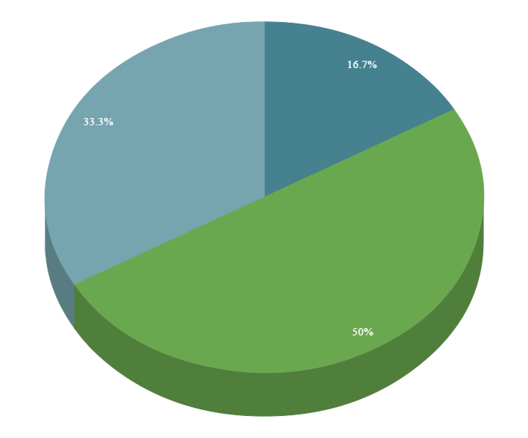
You can copy&paste graphs from Google Sheets

Slide 44
Android project
Show and explain your web, app or software projects using these gadget templates.
Place your screenshot here

Slide 45
iPhone project
Show and explain your web, app or software projects using these gadget templates.
Place your screenshot here

Slide 46
Tablet project
Show and explain your web, app or software projects using these gadget templates.
Place your screenshot here

Slide 47
Desktop project
Show and explain your web, app or software projects using these gadget templates.
Place your screenshot here

Slide 48
Thanks!
Any questions?
You can find me at @username & user@mail.me

Slide 49
Credits
Special thanks to all the people who made and released these awesome resources for free:
Presentation template by SlidesCarnival
Photographs by Unsplash

Slide 50
Presentation design
This presentation uses the following typographies and colors:
Titles: Montserrat
Body copy: PT Serif
You can download the fonts on these pages:
https://www.fontsquirrel.com/fonts/montserrat
https://www.fontsquirrel.com/fonts/pt-serif
Petroleum #004046
Aqua #00bfc9
Teal #007074
Green #6aa84f
You don’t need to keep this slide in your presentation. It’s only here to serve you as a design guide if you need to create new slides or download the fonts to edit the presentation in PowerPoint®

Slide 51
SlidesCarnival icons are editable shapes.
This means that you can:
Resize them without losing quality.
Change fill color and opacity.
Change line color, width and style.
Isn’t that nice? :)
Examples:

Slide 52
😉
Now you can use any emoji as an icon!
And of course it resizes without losing quality and you can change the color.
How? Follow Google instructions https://twitter.com/googledocs/status/730087240156643328
✋👆👉👍👤👦👧👨👩👪💃🏃💑❤😂😉😋😒😭👶😸🐟🍒🍔💣📌📖🔨🎃🎈🎨🏈🏰🌏🔌🔑 and many more...

